Slide 1
Network representation and analysis: strategies and limitations

Slide 2
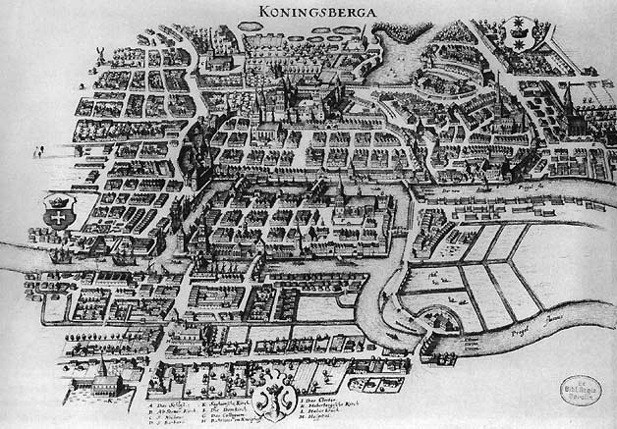

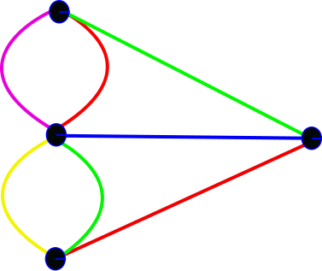
Network analysis: background
Biological network analysis: originated using tools and concepts from network and graph theory and social network analysis.
Graph theory: set of abstract concepts and methods that can be used to visualize and analyse biological networks.
First formulation of graph theory: The problem of the seven bridges of Koenigsberg (Kaliningrad).
“Solved” by Leonard Euler in 1735.
Set the basis of graph theory and the idea of topology.
Images taken under Creative Commons Attribution-Share Alike 3.0 Unported license from:
http://commons.wikimedia.org/wiki/File:Konigsberg_bridges.png
http://commons.wikimedia.org/wiki/File:K%C3%B6nigsberger_br%C3%BCcken.svg

Slide 3
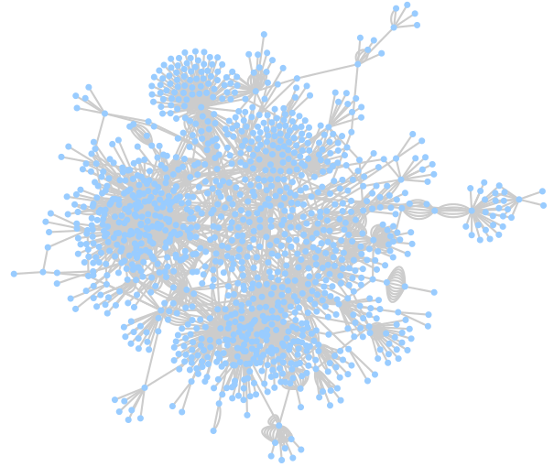
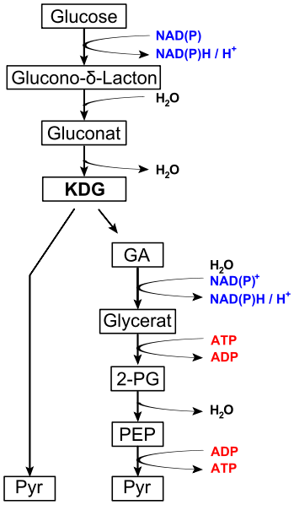
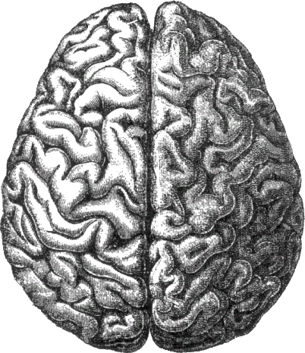

Network analysis in biology
Complex biological systems can be represented and analysed as networks, using the tools that graph theory gives us:
Ecological networks (food webs, species interaction networks…)
Neurological networks
Metabolic networks
Signalling networks
Genetic interaction networks
Gene regulatory networks
Protein-protein interaction networks
…
Images taken under Creative Commons Attribution-Share Alike 3.0 Unported license from:
http://commons.wikimedia.org/wiki/File:Lions_hunting_Africa.jpg
http://commons.wikimedia.org/wiki/File:Entner%E2%80%93Doudoroff_pathway_non-phosphorylative.svg
http://commons.wikimedia.org/wiki/File:Gene_Regulatory_Network_for_Initiation_of_Sporulation_in_Bacillus_subtilis.png

Slide 4
Example of a PPI Network
>80% of proteins are all connected in one giant cluster of PPI network
Small-world effect median network distance – 6 steps
Nodes – proteins
Edges – interactions

Slide 5
Properties of PPI networks
Small world effect - Interconnected binding networks could indiscriminately spread perturbations, how individual pathways can be turned on and off without upsetting the whole system ?
Transitivity/ Clustering - A network shows clustering if the probability of pair of nodes being adjacent is higher when the two nodes have a common neighbor.
Functions are likely to be carried out in a highly modular manner.
High clustering => High modularity
Notes:
NOT SO SURE ABOUT THIS ONE, CHECK WITH SANDRA

Slide 6
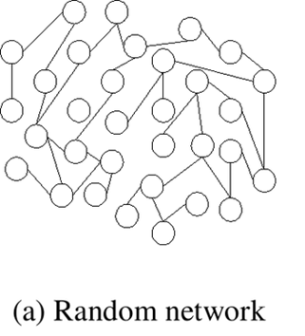
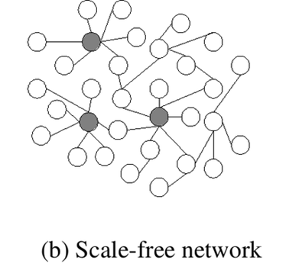
Properties of PPI networks
Scale-free effect - the majority of nodes in a scale-free network have only a few connections to other nodes, whereas some nodes (hubs) are connected to many other nodes in the network

Slide 7
Properties of PPI networks
Scale-free networks are stable - if failures occur at random and the vast majority of proteins are those with a small degree of connectivity, the likelihood that a protein hub would be affected is small.
Even if a hub-failure occurs, the network will generally not lose its connectedness, due to the remaining hubs.
However, if we loose a few major hubs from the network, the network is turned into a set of rather isolated graphs (so they are vulnerable to targeted attack).
Many cancer-linked proteins are hub proteins (e.g. P53).
Given the current limited coverage levels and variable quality of interaction data, the observed scale-free topology of existing interactome maps cannot be confidently extrapolated to complete interactomes.

Slide 8
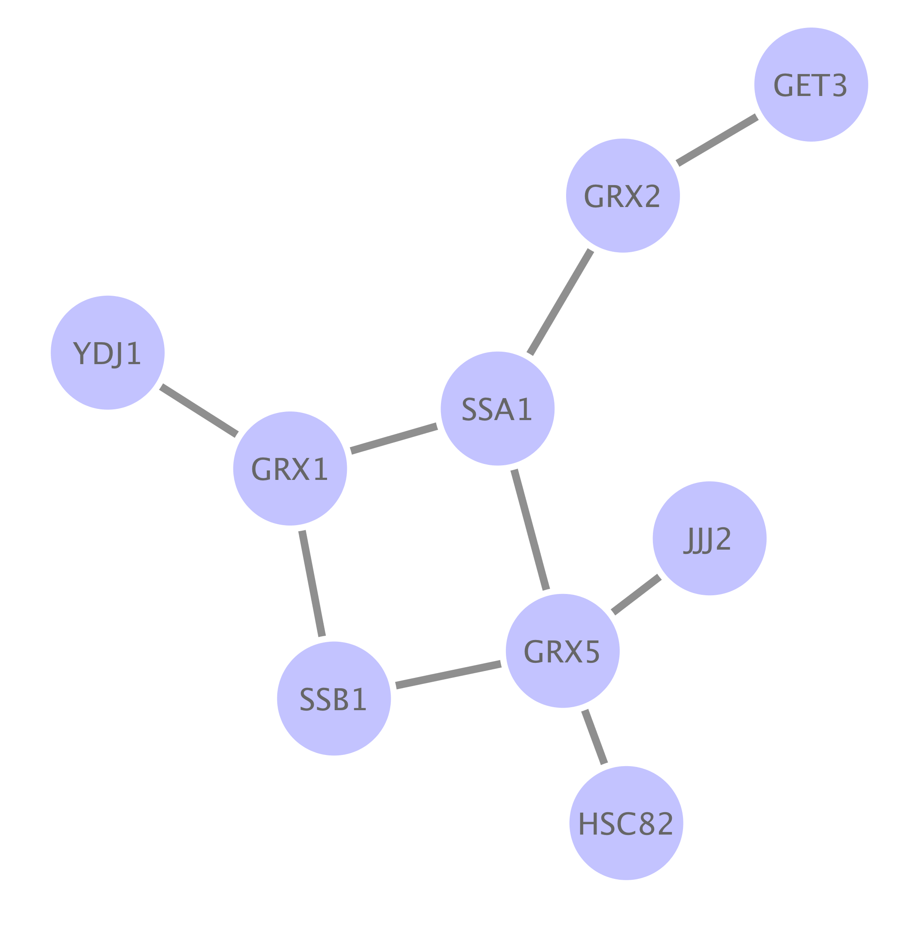
Network analysis: typical workflows
Type I:
Enrichment of gene sets in pre-existing network

Slide 9
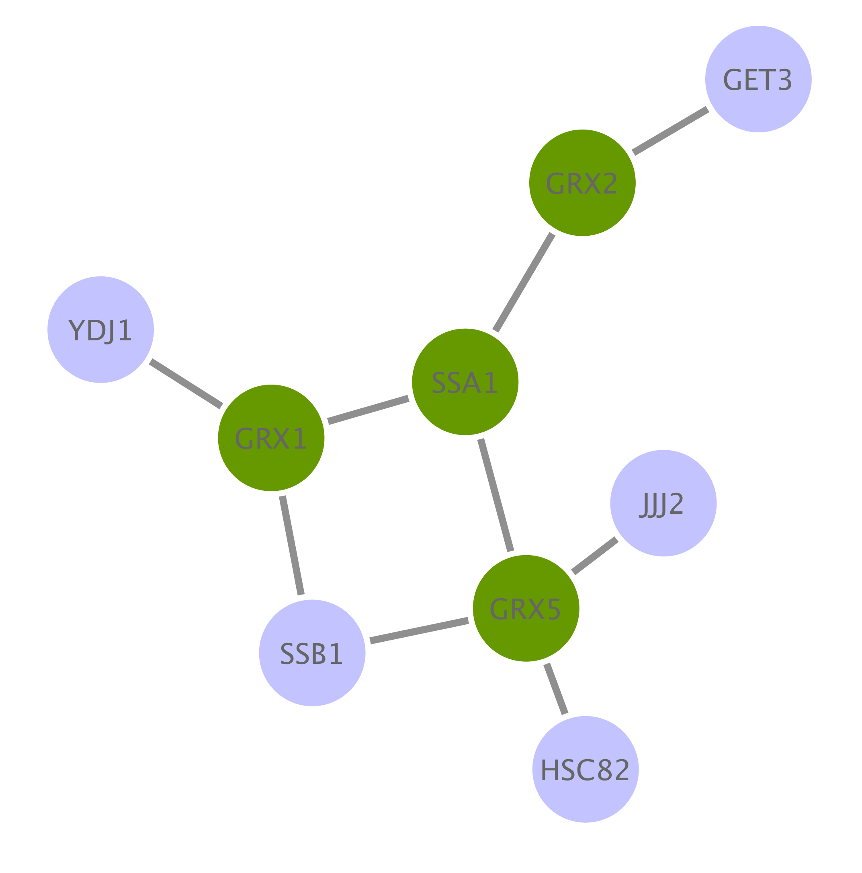
Network analysis: typical workflows
Type I:
Enrichment of gene sets in pre-existing network

Slide 10
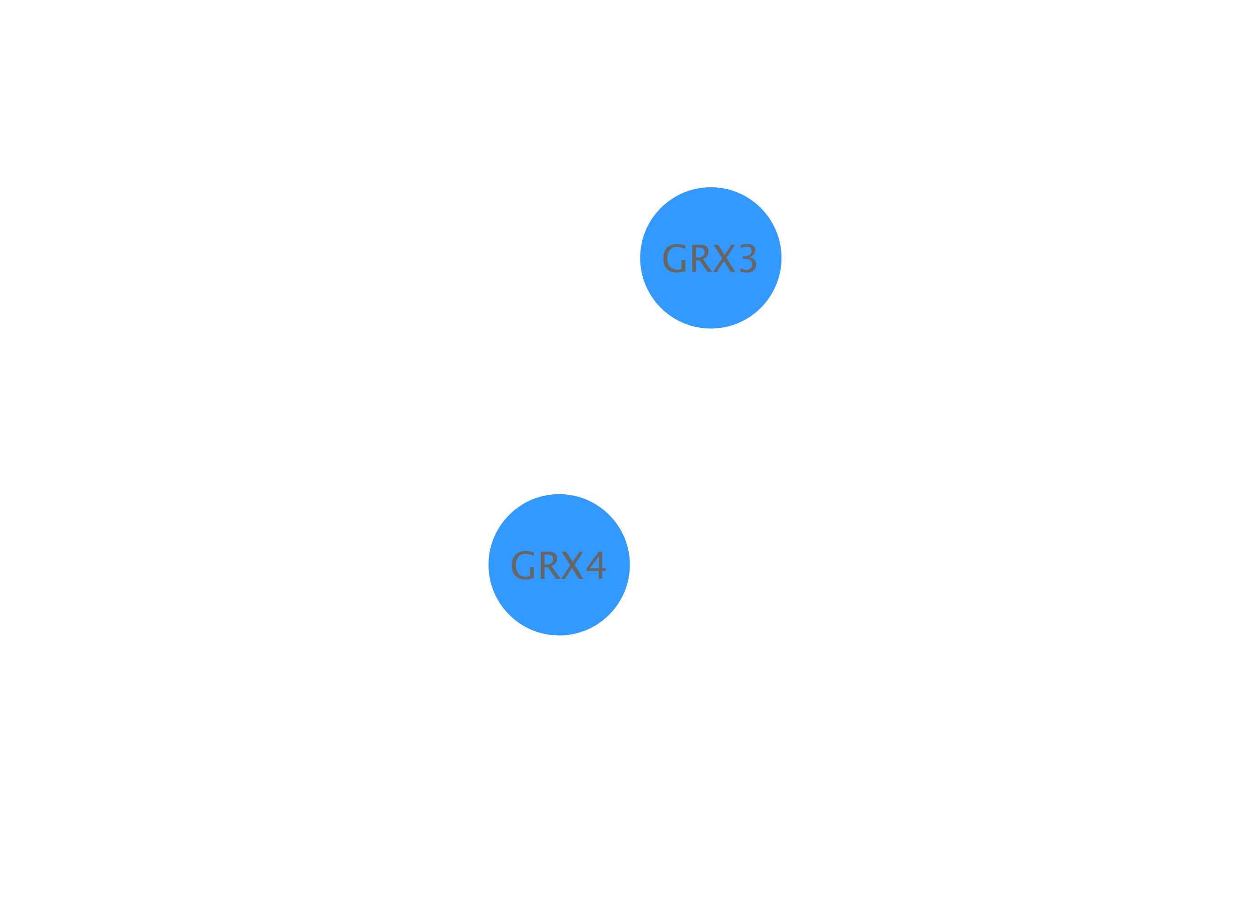
Network analysis: typical workflows
Type II:
De novo network construction + clustering analysis

Slide 11
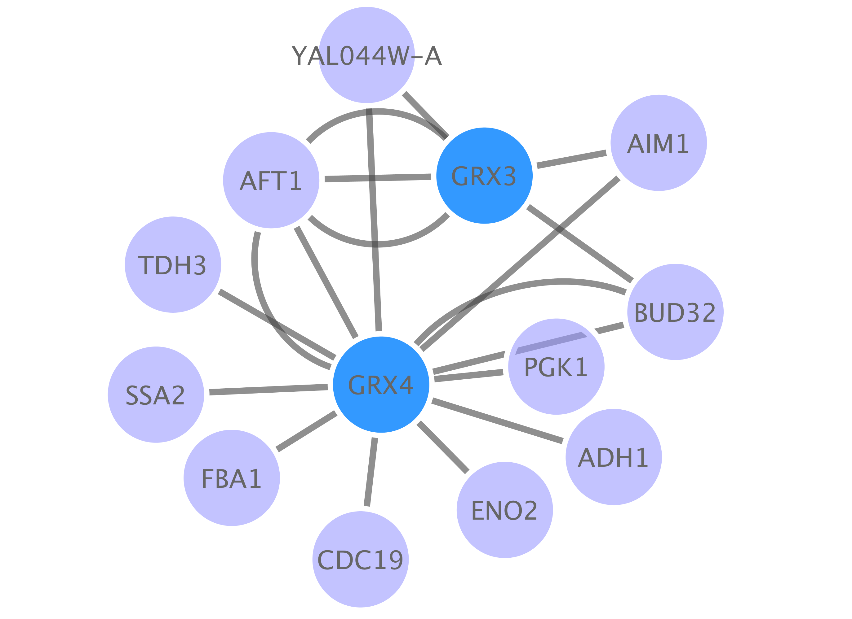
Network analysis: typical workflows
Type II:
De novo network construction + clustering analysis

Slide 12
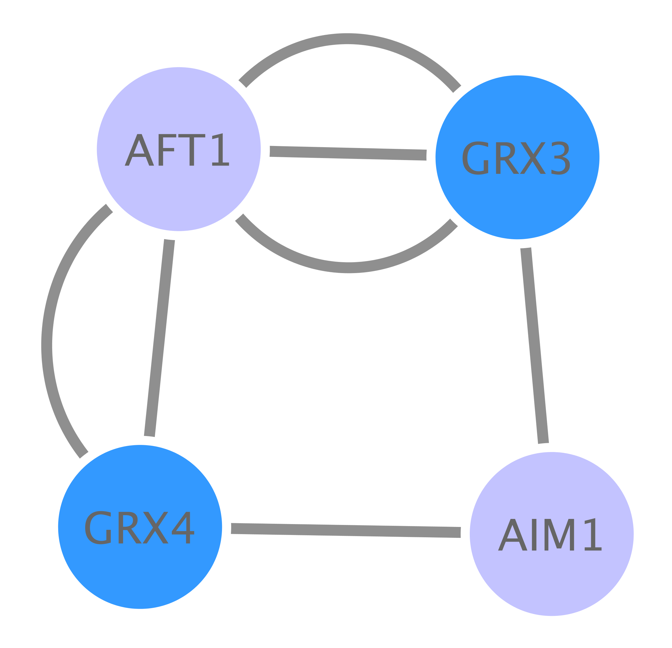
Network analysis: typical workflows
Type II:
De novo network construction + clustering analysis

Slide 13

Network analysis: typical workflows
Type III:
Directional network analysis

Slide 14

Network analysis: typical workflows
Type III:
Directional network analysis

Slide 15
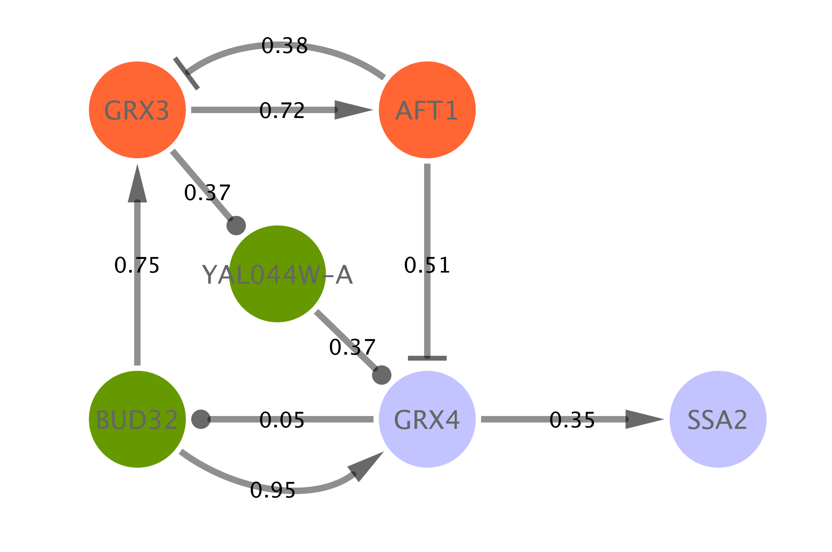
Network analysis: typical workflows
Type III:
Directional network analysis / network modeling

Slide 16


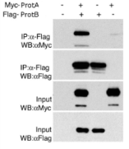
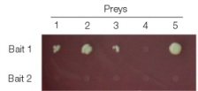

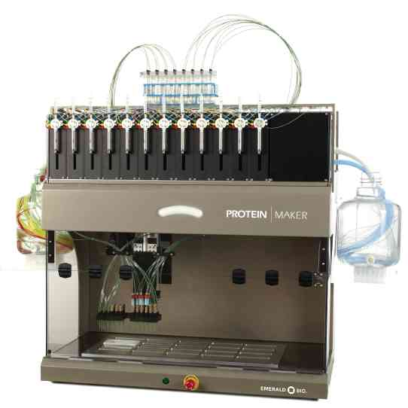
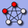

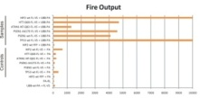
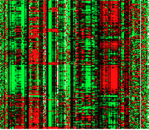


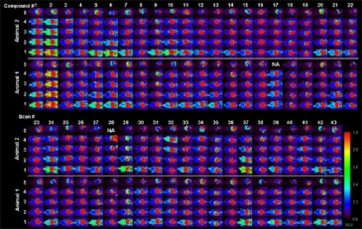
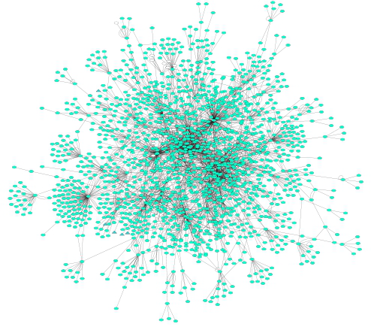
PPI Network analysis: building a network
primary databases
experimental data
meta-databases and predictive databases
Challenges:
Identifiers
Redundancies
Selection of the data
Type
Quality
Mapping external information

Slide 17
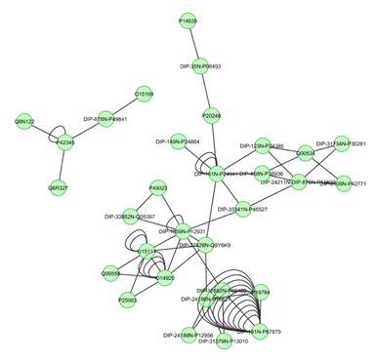
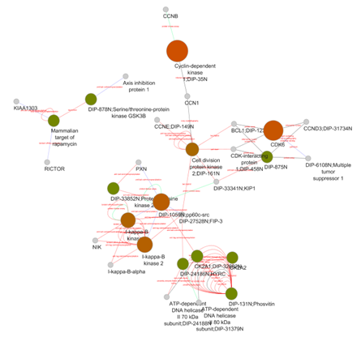
PPI Network analysis: filtering and enriching your data
Confidence filtering
Detection method
Number of publications
Confidence score
...
Overlaying external information
Expression data
Protein abundance
Enzymatic assay values
...

Slide 18
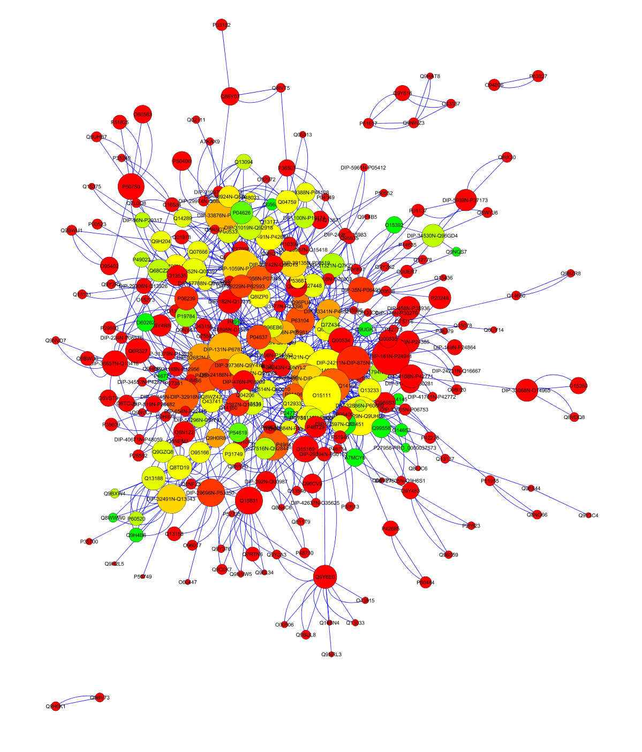
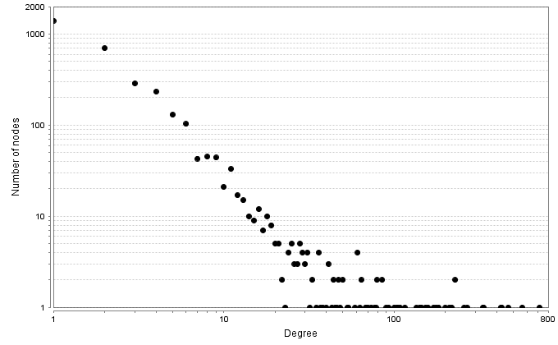
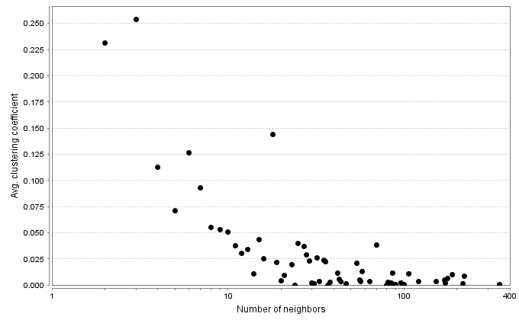
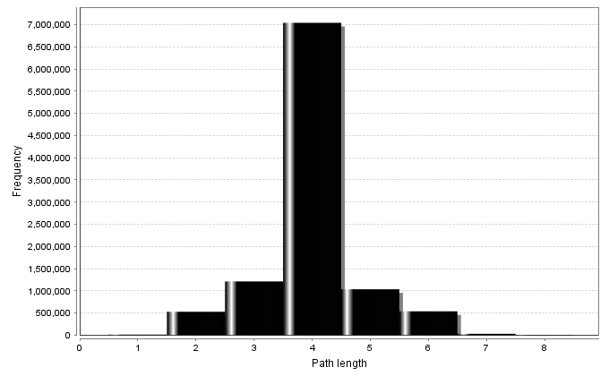
PPI Network topological analysis
Degree distribution
Average clustering coefficient distribution
Shortest path length distribution

Slide 19
PPI Network topological analysis
Betweenness centrality:
Measure of a node's centrality in a network.
Number of shortest paths from every end of the network that pass through that node.
Gives a good estimation of the importance of a node (protein) in a network (signalling, scaffolding…).

Slide 20
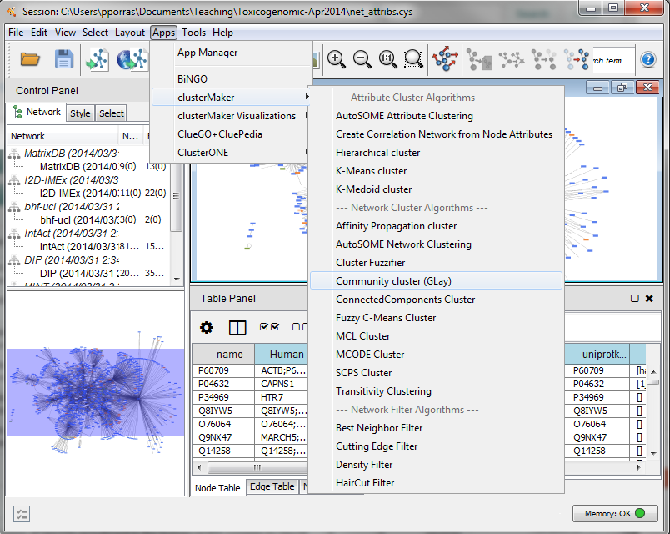
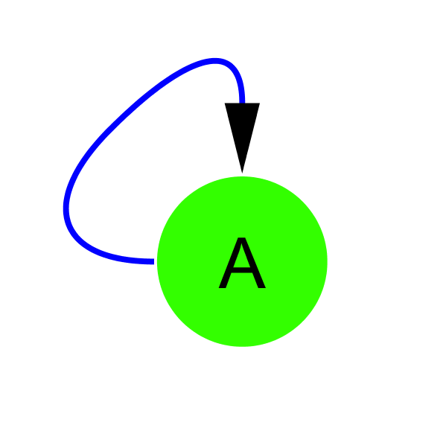
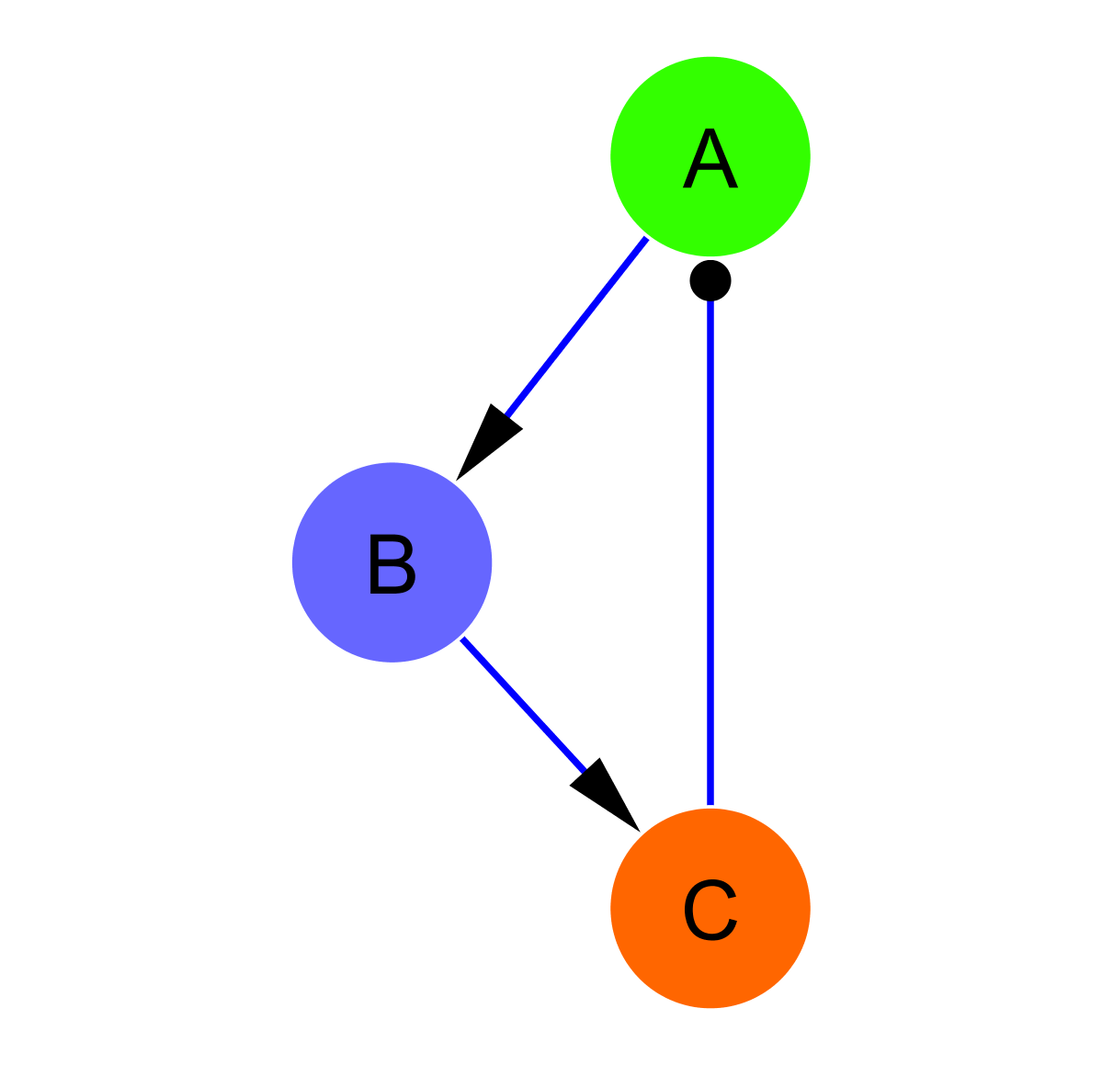
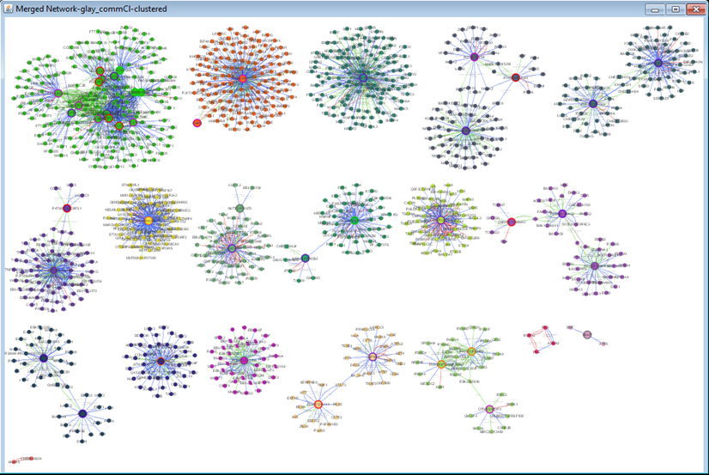
PPI Network topological analysis: cluster and motif search
Clustering search
Common motifs

Slide 21
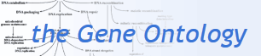
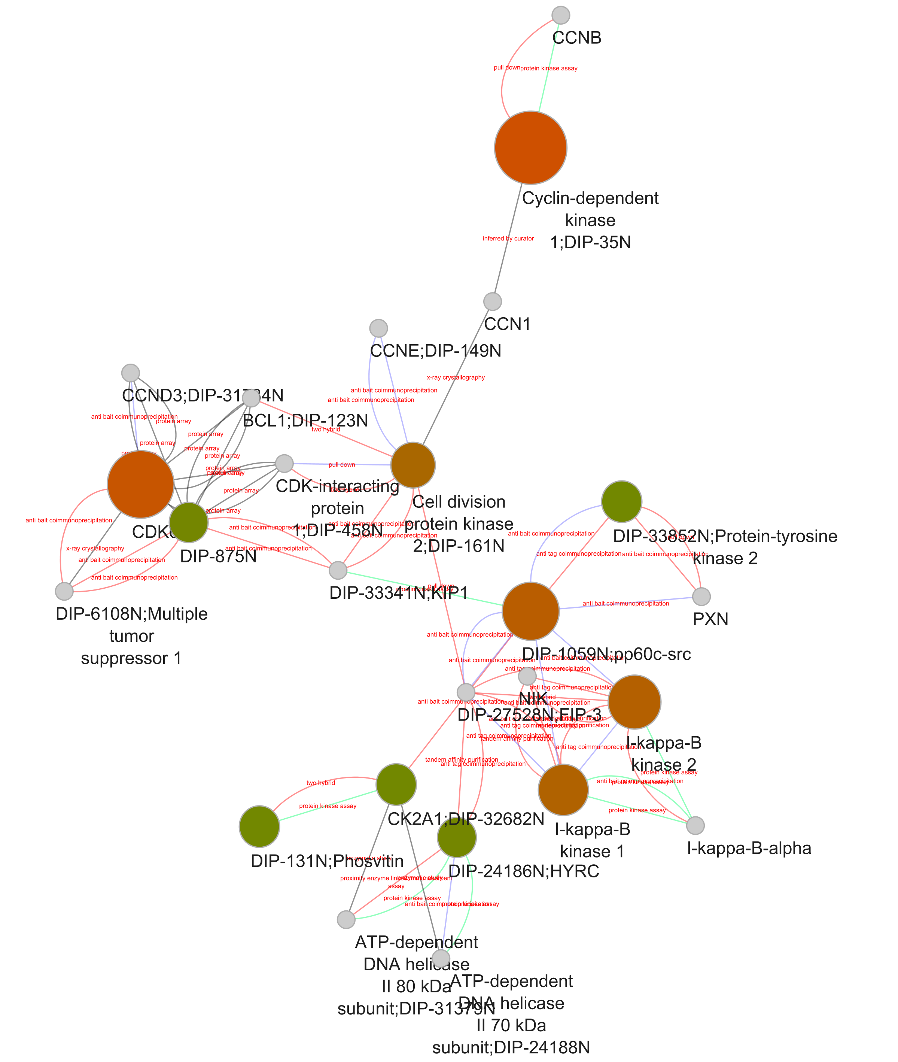
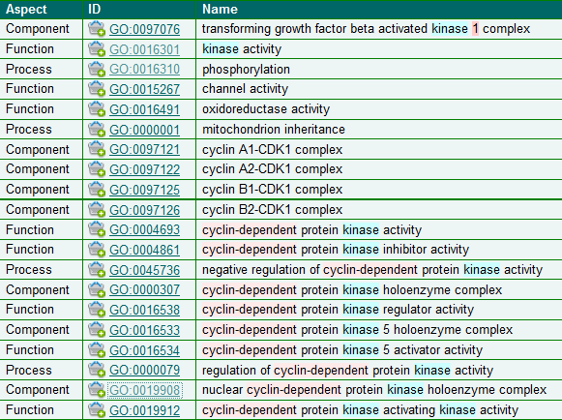

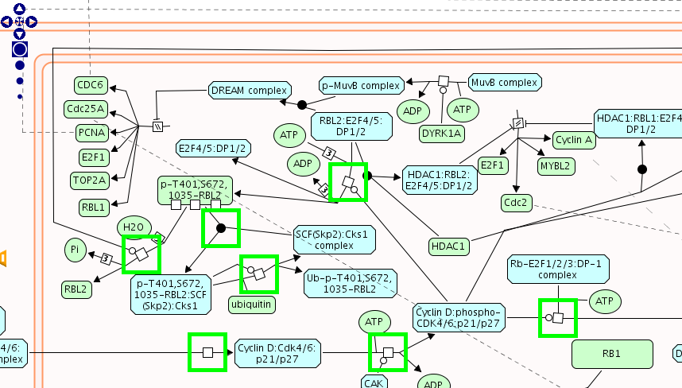
PPI Network analysis: annotation enrichment analysis
GO:0019908:
nuclear cyclin-dependent protein kinase holoenzyme complex
REACT_821.2:
Cyclin D associated events in G1

Slide 22
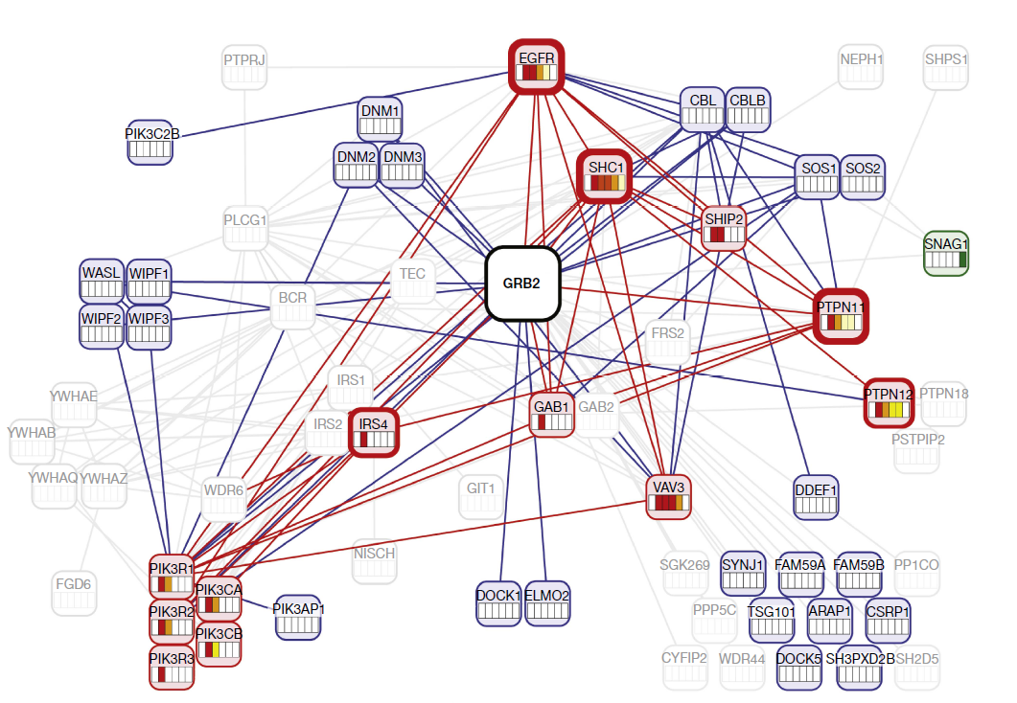
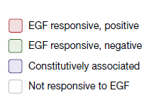
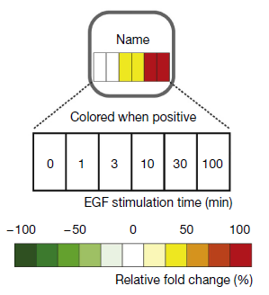
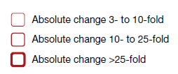
PPI Network representation challenges
Blisson et al., 2011, Nature Biotechnology, PMID: 21706016.

